Slide 1
What Does It Mean to Be Presbyterian?
Week 1: Presbyterian Confessions

Slide 2
Jesus is Lord.

Slide 3
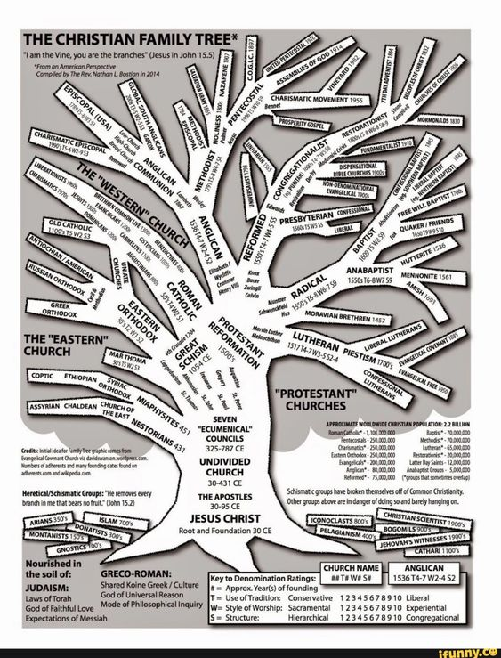

Slide 4
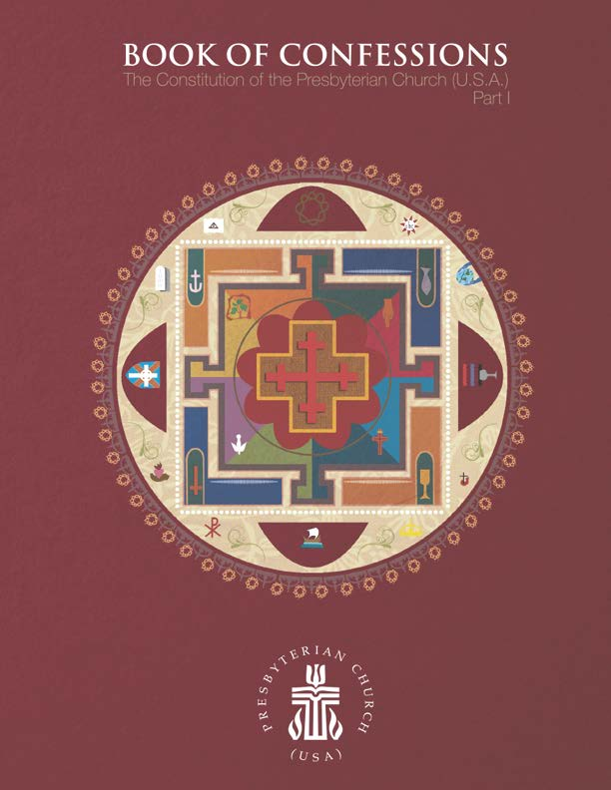

Slide 5
Jesus Christ
Scripture
Confessions

Slide 6
Ancient Confessions
Nicene Creed
Apostles’ Creed

Slide 7
The Nicene Creed
We believe in one God,
the Father, the Almighty,
maker of heaven and earth,
of all that is,
seen and unseen.

Slide 8
The Nicene Creed (cont’d.)
We believe in one Lord, Jesus Christ,
the only Son of God,
eternally begotten of the Father,
God from God, Light from Light,
true God from true God,
begotten, not made,
of one Being with the Father;
through him all things were made.
For us and for our salvation
he came down from heaven,
was incarnate of the Holy Spirit and the Virgin Mary
and became truly human.
For our sake he was crucified under Pontius Pilate;
he suffered death and was buried.
On the third day he rose again
in accordance with the Scriptures;
he ascended into heaven
and is seated at the right hand of the Father.
He will come again in glory to judge the living and the dead,
and his kingdom will have no end.

Slide 9
The Nicene Creed (cont’d.)
We believe in the Holy Spirit, the Lord, the giver of life,
who proceeds from the Father and the Son,
who with the Father and the Son is worshiped and glorified,
who has spoken through the prophets.
We believe in one holy catholic and apostolic Church.
We acknowledge one baptism for the forgiveness of sins.
We look for the resurrection of the dead,
and the life of the world to come. Amen.

Slide 10
Reformation-Era Reformed
Confessions
Scots Confession
Heidelberg Catechism
Second Helvetic Confession
Westminster Confession of Faith and Westminster Longer and Shorter Catechisms

Slide 11
from The Westminster Confession of Faith
“God from all eternity did by the most wise and holy counsel of his own will, freely and unchangeably ordain whatsoever comes to pass; yet so as thereby neither is God the author of sin; nor is violence offered to the will of the creatures, nor is the liberty or contingency of second causes taken away, but rather established.”
“By the decree of God, for the manifestation of his glory, some men and angels are predestinated unto everlasting life, and others fore-ordained to everlasting death.”

Slide 12
from The Westminster Confession of Faith
“The doctrine of this high mystery of predestination is to be handled with special prudence and care, that men attending the will of God revealed in his Word, and yielding obedience thereunto, may, from the certainty of their effectual vocation, be assured of their eternal election. So shall this doctrine afford matter of praise, reverence, and admiration of God; and of humility, diligence, and abundant consolation to all that sincerely obey the gospel.”

Slide 13
from The Westminster Confession of Faith
“God alone is Lord of the conscience, and hath left it free from the doctrines and commandments of men which are in anything contrary to his Word, or beside it in matters of faith or worship.”

Slide 14
Modern Reformed
Confessions
Theological Declaration of Barmen
Confession of 1967
Confession of Belhar
A Brief Statement of Faith

Slide 15
from The Confession of Belhar
“We believe…that unity is…both a gift and an obligation for the church of Jesus Christ; that through the working of God’s Spirit it is a binding force, yet simultaneously a reality which must be earnestly pursued and sought: one which the people of God must continually be built up to attain; that this unity must become visible so that the world may believe that separation, enmity and hatred between people and groups is sin which Christ has already conquered, and accordingly that anything which threatens this unity may have no place in the church and must be resisted…”

Slide 16
from The Confession of Belhar (cont’d.)
“We believe that God has revealed God’s self as the one who wishes to bring about justice and true peace among people; that God, in a world full of injustice and enmity, is in a special way the God of the destitute, the poor and the wronged; that God calls the church to follow God in this; for God brings justice to the oppressed
and gives bread to the hungry; … that the church must therefore stand by people in any form of suffering and need, which implies, among other things, that the church must witness against and strive against any form of injustice, so that justice may roll down like waters, and righteousness like an ever-flowing stream…

Slide 17
from The Confession of Belhar (cont’d.)
“…that the church as the possession of God must stand where the Lord stands, namely against injustice and with the wronged; that in following Christ the church must witness against all the powerful and privileged who selfishly seek their own interests and thus control and harm others. Therefore, we reject any ideology which would legitimate forms of injustice and any doctrine which is unwilling to resist such an ideology in the name of the gospel. We believe that, in obedience to Jesus Christ, its only head, the church is called to confess and to do all these things, even though the authorities and human laws might forbid them and punishment and suffering be the consequence. Jesus is Lord.”

